Slide 2
Hardware innovations
Drastic reduction in memory price
Ability to fabricate large memory in small chips
Multi-core CPU
Interruptible power supply
64-bit OS
Specialized hardware which even process data in upper cache of CPU
HANA installation only works on specialized hardware certified by SAP – HP, Lenovo, Dell
Software Innovations
Able to compress data and store
Row store v/s Column Store
Able to use the OS level virtualization
Process data parallel
Insert-only approach
No Aggregation

Slide 3
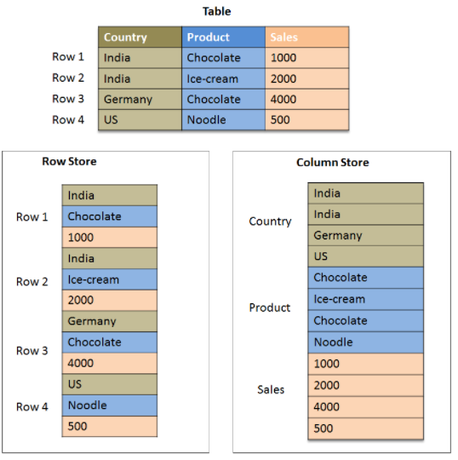
Aggregates are built faster (SUM, MIN, MAX, AVG, COUNT)
Parallel processing
Speed up read, we used to create indexes
No need to store duplicates
Processing only numbers
Insert only boost the processing

